Slide 1
Software QA and Testing with Automation using Selenium IDE Course 1, Class 2 Deck 2
Instructor
David F Wagoner
PMP, CSQE, CMQ/OE

Slide 2
A Note
From this point forward, we delve more into the details of testing efforts and the IDE
There are a couple things to note regarding the textbook
Discount Chapter 6 as it is mainly about white-box testing, code reviews and other quality activities that rarely occur with Testing input

Slide 3
Unstructured Testing
Testing can occur as formal or informal
Formal
This means the test plans are defined, scripts are documented and followed and results of testing are reported both in the interim (during the Test phase to identify defects and support remediation) and at the conclusion of testing (for record keeping purposes)
Informal
Ad-hoc, no defined plan or scripts. Unstructured hacking away at a site hoping to find a problem

Slide 4
Approaches
Test-to-Fail
The alternative to Test-to-Pass that seeks to exercise basic functions and try creative approaches to breaking the site.
Employs the use of Scenarios to test end-to-end business processes
Test-to-Pass
Rarely used except to checkout new functions for functions around a main path on prototypes
Also used to test environments (Test, Development, UAT and production) to verify the configuration

Slide 5
Approaches (cont.)
Equivalence Partitioning (EP)
When there exists a large set of test case that can be executed but lack time and resources to do so
There needs to be an approach to define a working set that:
Adequately tests:
Core and ancillary functions
Business Processes
Interfaces
EP will often employ prioritization of scripts and allocation of them to the iterations of building and testing

Slide 6
Approaches (cont.)
Data Testing
This boils down to two things to observe and track:
Data is stored and retrieved as entered, except when a business process transforms it.
Transformations or aggregation of data is performed accurately, according to the algorithm (which should be in the requirements or design specification)

Slide 7
Approaches (cont.)
Boundary Testing
This tests the entry of values for specific fields
Engineering data and heuristics state that errors often occur at the boundaries of the data
If a field is to enter a SSN, the boundaries are
Lower (0), Upper (999-99-9999 or 000-00-0000)

Slide 8
Approaches (cont.)
Interface Testing
There are numerous sorts of interfaces in a system
Interfaces to hardware such as printers, networks, servers…etc.
Interfaces formed on the basis of data exchanges among systems/servers
Interfaces within a business process or interfaces between system functions and modules
Interfaces at low-level program code that cannot be observed
The same Engineering heuristic as boundary testing applies here, Engineering data and heuristics state that errors often occur at the interfaces of systems

Slide 9
Approaches (cont.)
These approaches generally require a lot of information about the system, how it’s constructed and how it acts
In large, mature organizations much of this insight is gained in Requirements and Design reviews
Web site organizations are rarely large or mature in their processes
Your success depends on maintaining relationships with developers to be able to get more of this knowledge

Slide 10
Approaches (cont.)
Program Code
Program code is tested during the Coding phase as Unit testing
Going back to Class 1 and the nature of development being constructive, programmers have a natural conflict-of-interest; they subconsciously avoid testing out side the main path of code execution
As testers, it’s up to you to get this information as to program execution, multiple paths processing can take and conditions to be met for a given path

Slide 11
Approaches (cont.)
Program Code
Integration Testing, the assembly of units into a system module/function, or the entire system, is also conducted by developers
The final build that meets their perception of ‘what is supposed to be delivered to test’ is what is delivered to the test environment or server
A Test Readiness Review can help to validate whether what is delivered is correct before expending test resources
After loading source code/html to the test environment or service, run basic tests (a great role for automation!) to verify everything got there!
This is a form of configuration testing

Slide 12
Lab
Web Site Requirements
Requirements Statements
Atomic
Uniquely Numbered
Testable
Shall vs. May

Slide 13
Testing Tools
Life Cycle Tools
Requirements Management
Software tools, Spreadsheets
Requirements Traceability Matrix (RTM)
Configuration Management Repositories
Change Requests/Defect Management
Configuration Control/Version Management

Slide 14
Testing Tools
Office Tools
Word Processing – Test scripts/Scenarios
Spreadsheets
RTM
Defect Burn-Down Charts
State Transition Diagrams
Show the transitions through a business process
Object Transition Modeling
Done visually or textually or in a spreadsheet

Slide 15
Object Transition Model (OTM)
Show the transition from:
One page to another
One site to another (outbound)
May include return path
Page to media content
Annotate to show exchange of data or information flow

Slide 16
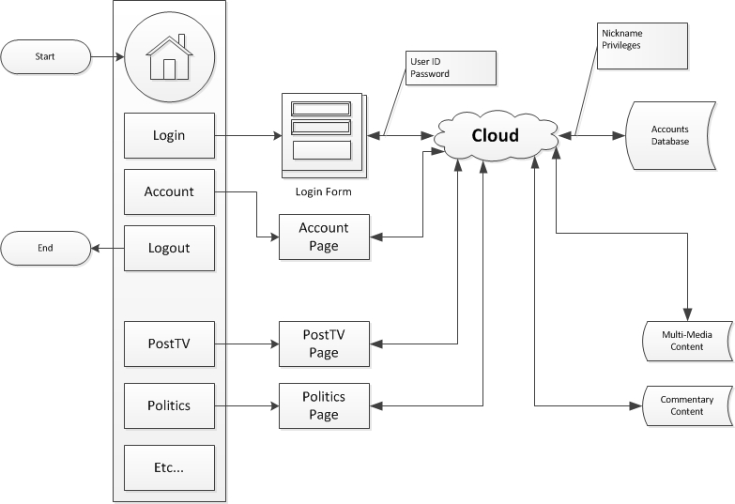
Visual OTM

Slide 17
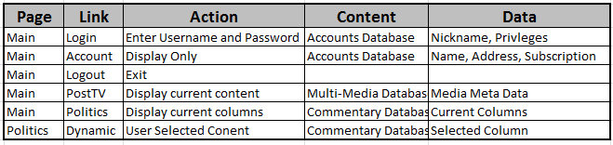
Textual OTM

Slide 18
The RTM
Rows
Lists each requirement to be developed by unique number and may include the title
Columns
Lists the related work products that further develop the requirement
Design specifications
Use cases
Code files and version numbers
Test cases that verify proper function
May include Acceptance Test cases

Slide 19
Testing Metrics
Using the Defect management tool, there are many graphs that can be generated by any tool.
Show defects by priority and status (Open, Fixed, Verified, Closed)
Show productivity by the number of defects closed over time vs. the defects opened
Defect Burn-down charts

Slide 20
Defect Burn-down Chart
This is used to list:
Defects planned to be fixed (see Test Plan)
Defects uncovered in testing (see defect repositories)
Their priorities
High (Must be fixed)
Medium (Would be good to fix, if time allows)
Low (May be deferred)
Their current disposition
Fixed
Verified
Closed
Using a spreadsheet allows easy sorting by priority and disposition
Sometimes placed on a wall common to the project team so everyone can see the daily status

Slide 21
Engineering Test Metrics
Again, borrowing from IEEE
Standard 982.1 Dictionary of Measures
Defect Density
Functional Test Coverage
Mean Time Between Failure
Cyclomatic Complexity

Slide 22
Test Effectiveness
Bug Seeding
A method of inserting bugs into software to determine how effectively defects are detected and removed
The bugs are documented as to location so they can be removed before deployment
Testers are unaware of their existence
Downside is it takes extra cycles and thus more time to do this and it increases risk (if a seeded bug is not removed)

Slide 23
Test Site
For this class, we are going to use The Washington Post
Tests will be limited to accessing and then testing the standard content:
Login/Logout
Sections
Top Menu Bar – Goes to section
Sections – verify menus and return to main page
Outbound links

Slide 24
Selenium
Selenium is a state-of-the-practice test automation tool used by many web development companies
Includes a macro recorder and very basic library function. This will be used in the section of the course (Part I)
The Selenium Web Driver is the more rigorous automated suite with several programming interfaces (perl, python…etc.). This will be used in Part II of this course. We’ll be using Python.

Slide 25
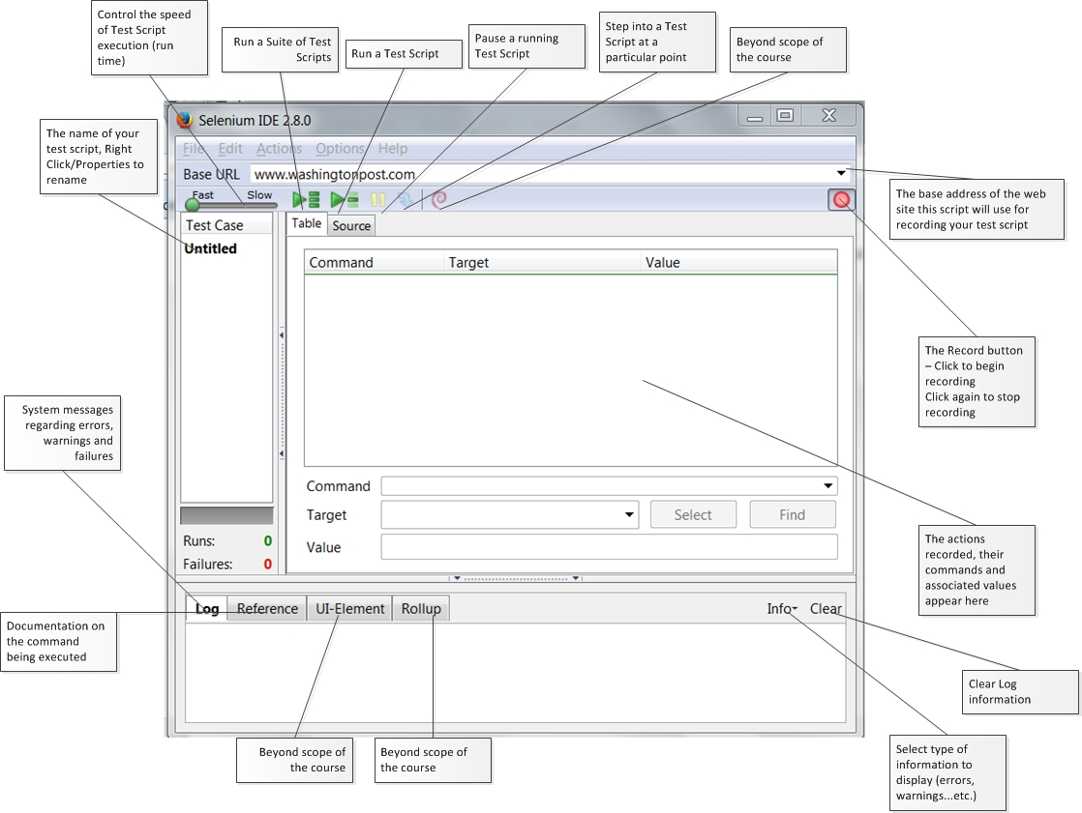

Slide 26
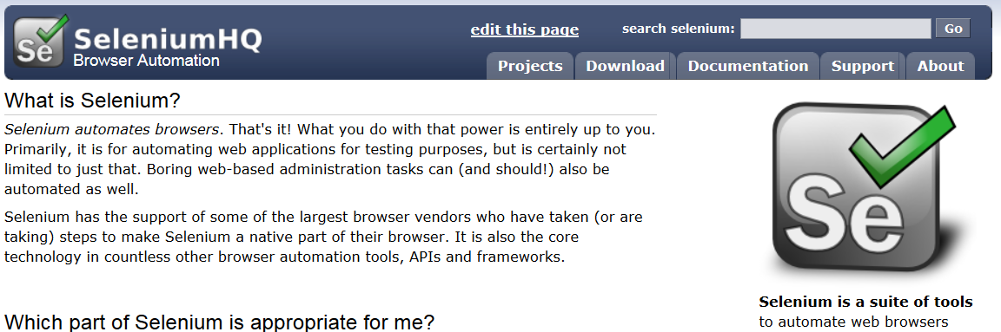
Downloading Plugin
This will need to be done again at the beginning of each class
www.seleniumhq.org – click on Download

Slide 27
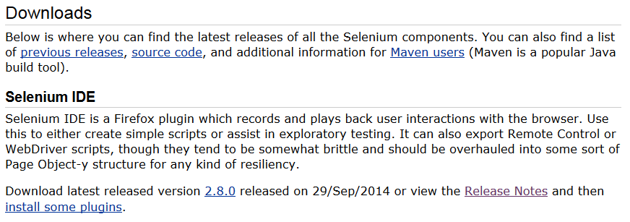
Downloading Plugin
Download the latest release, per bottom line below, click install in the Firefox window, Then restart the browser

Slide 28
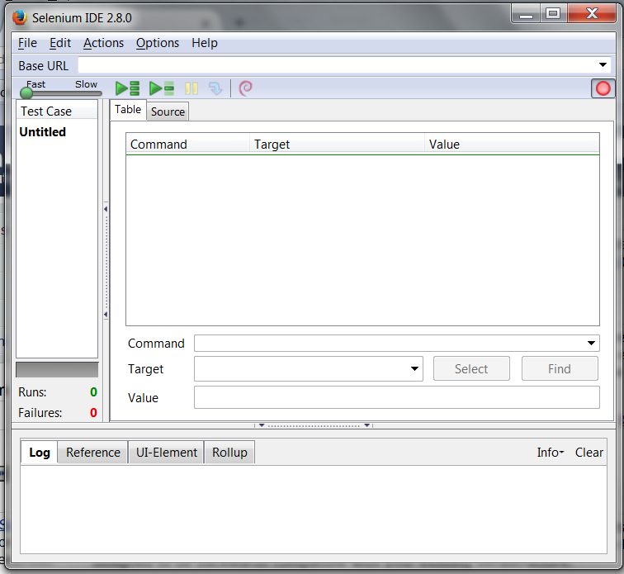
Opening the IDE
When Firefox restarts, click on Tools, Selenium IDE

Slide 29

Script Recording
Open up the web site to be tested
Click on the Record button
Begin browsing to build your test case
After exploring one page, store the test case using a meaningful name (e.g., ‘Main’ for main page of a site, ‘Login’ for the login page…etc.
Then proceed to the next page on the site to be tested and record another script

Slide 30
Running Scripts
Select a test script
Press Run
Next, Run the same script and move the speed control

Slide 31
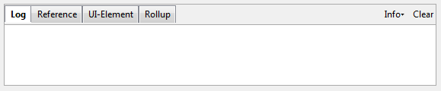
The Log
The bottom of the IDE contains a tabbed window
The log tab is used to log execution messages so you can see when a test succeeds or fails
This information is valuable for determining the cause of problems with your script
Press the Clear button to clear out old, irrelevant messages

Slide 32
Lab
Develop a set of test scripts to test:
Login
Account
And Second Level links to Politics, Opinions…etc.

